Slide 1
Lab 05 TCP
201910774 김건

Slide 2
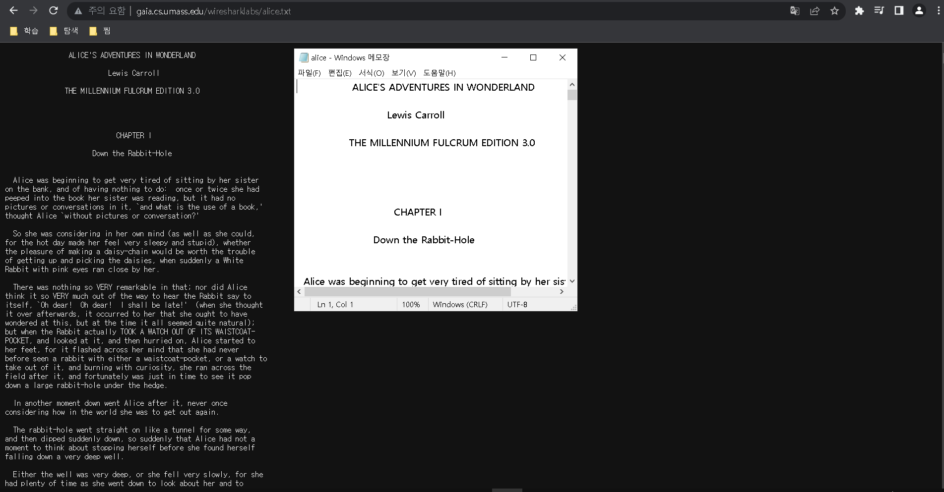
Instructions
Start up your web browser. Go the http://gaia.cs.umass.edu/wiresharklabs/alice.txt and retrieve an ASCII copy of Alice in Wonderland. Store this file somewhere on your computer.

Slide 3
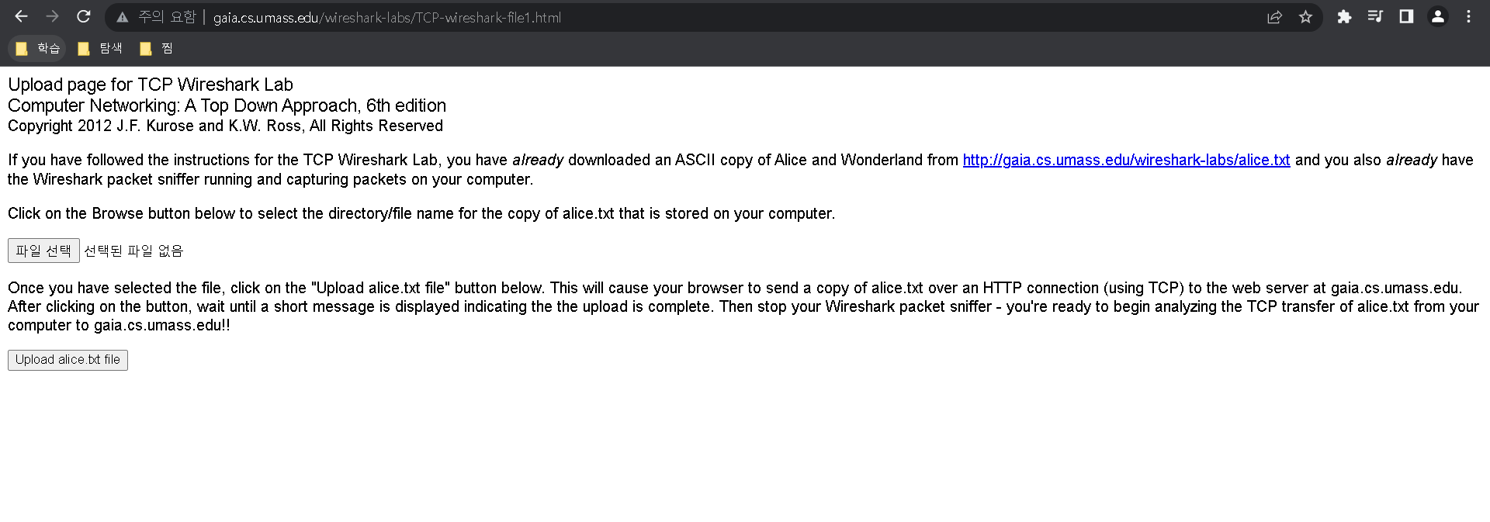
Instructions
Next go to http://gaia.cs.umass.edu/wireshark-labs/TCP-wireshark-file1.html.

Slide 4
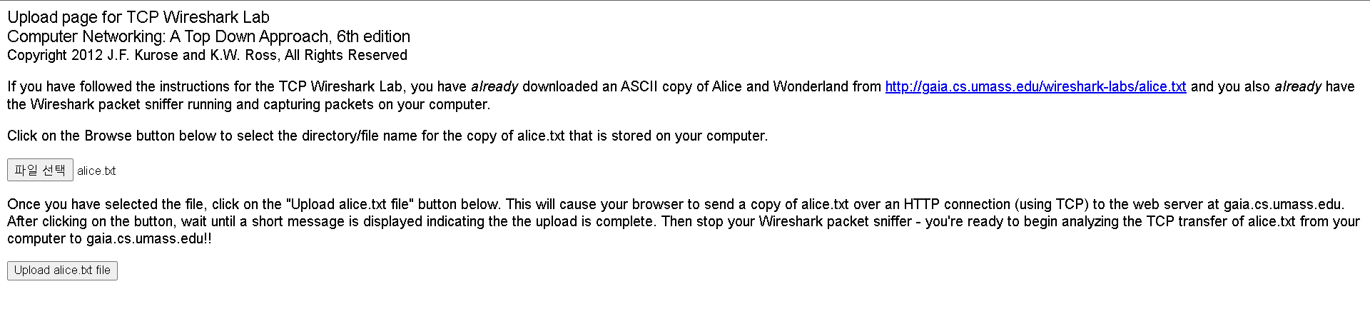
Instructions
Use the ‘Browse’ button to enter the name of the file (full path name) on your computer containing Alice in Wonderland (or do so manually). Don’t yet press the “Upload alice.txt file” button.

Slide 5
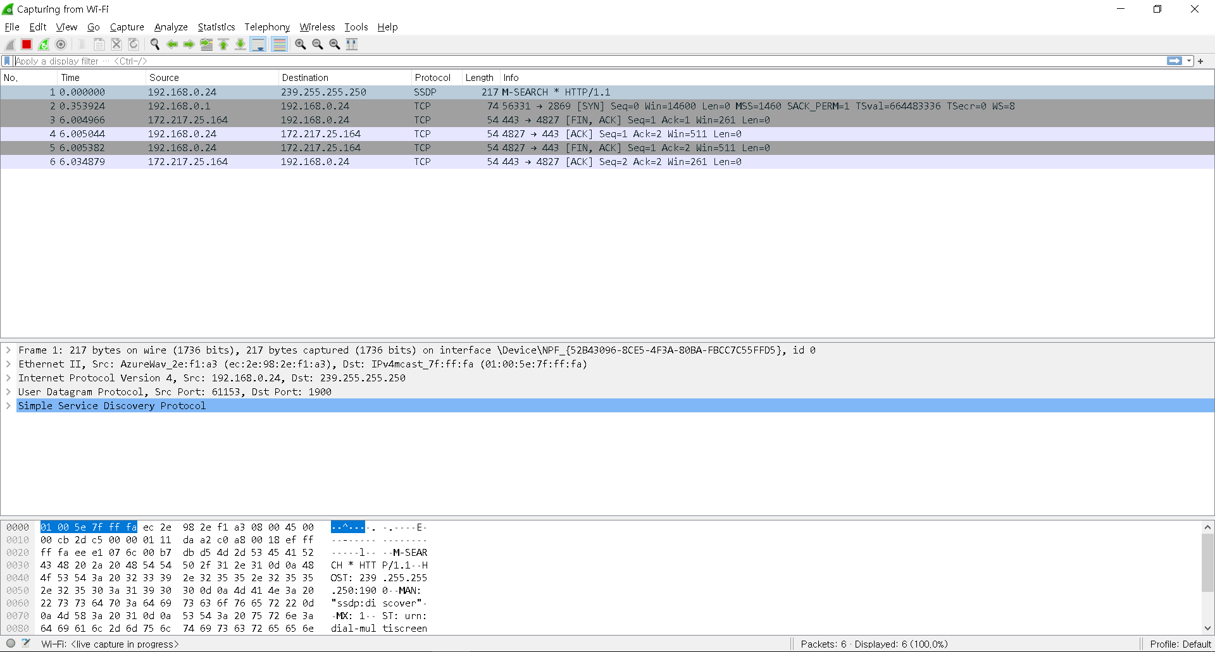
Instructions
Now start up Wireshark and begin packet capture (Capture->Start) and then press OK on the Wireshark Packet Capture Options screen (we’ll not need to select any options here).

Slide 6
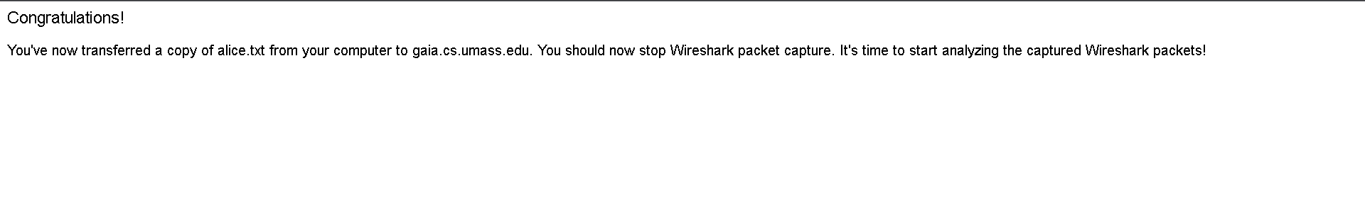
Instructions
Returning to your browser, press the “Upload alice.txt file” button to upload the file to the gaia.cs.umass.edu server. Once the file has been uploaded, a short congratulations message will be displayed in your browser window.

Slide 7
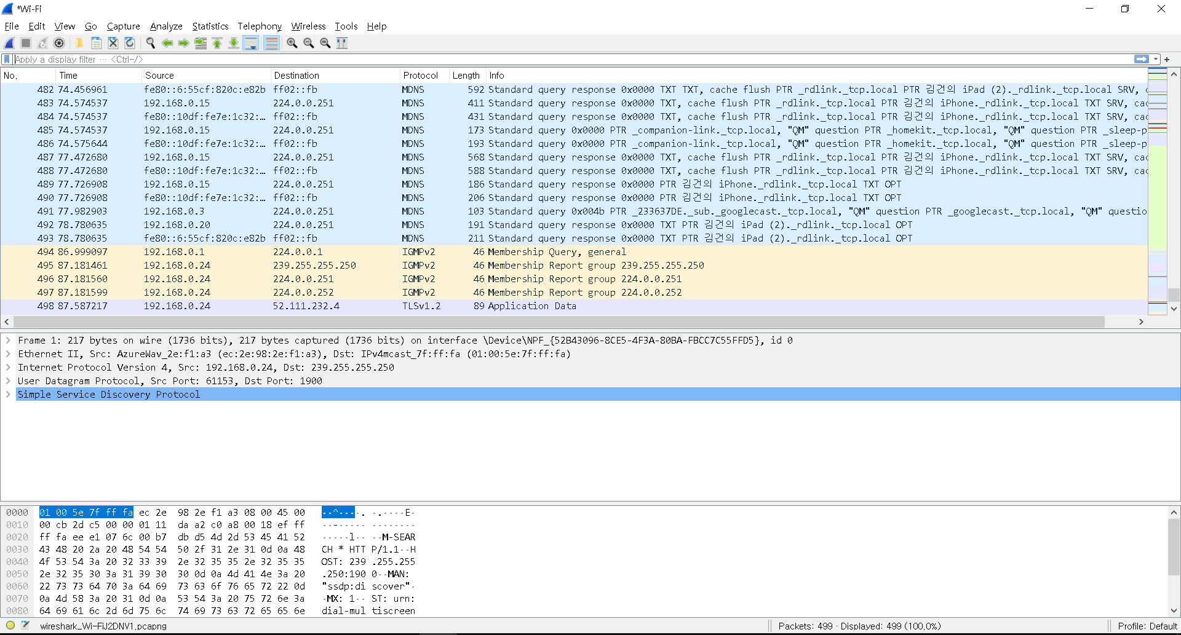
Instructions
Stop Wireshark packet capture.

Slide 8
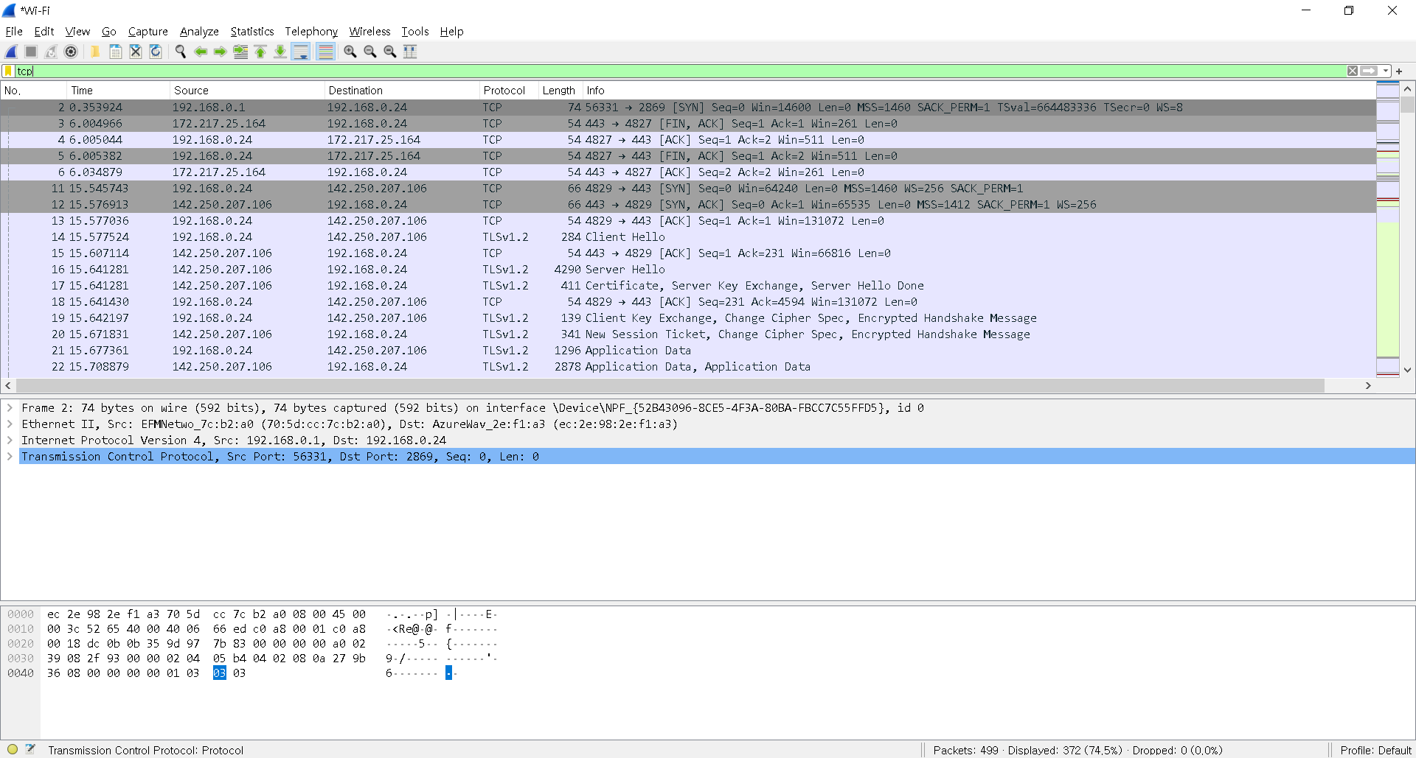
Instructions
Filter the packets displayed in the Wireshark window by entering “tcp” (lowercase)

Slide 9
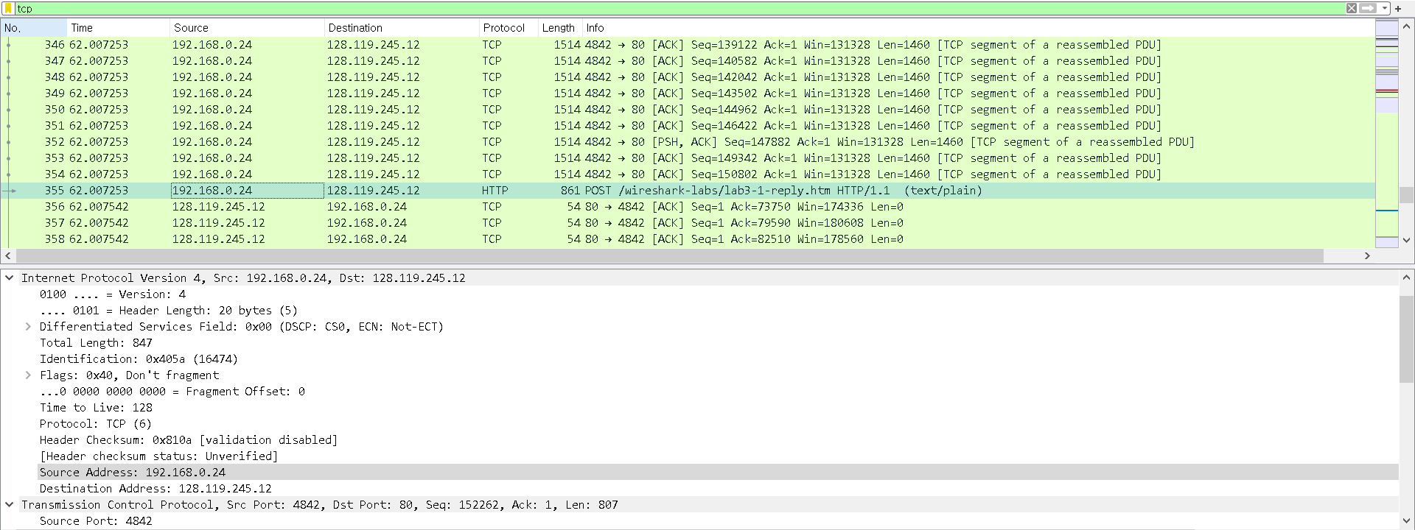
Questions (Part 1/5)
- What is the IP address and TCP port number used by the client computer (source) that is transferring the file to gaia.cs.umass.edu?
클라이언트의 IP 주소는 192.168.0.24
TCP 포트넘버는 4842 이다.

Slide 10
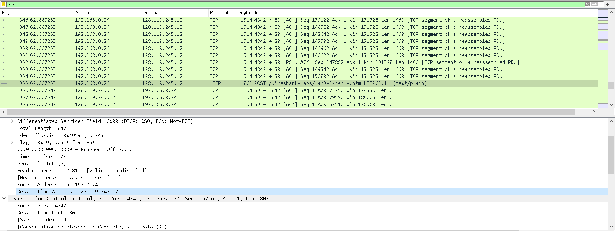
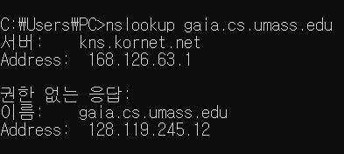
Questions (Part 1/5)
- What is the IP address of gaia.cs.umass.edu? On what port number is it sending and receiving TCP segments for this connection?
nslookup을 통해 서버의 IP 주소는 128.119.245.12 임을 알 수 있었으며,
이는 wireshark에서의 DA와 같으므로 서버의 TCP 포트넘버는 80임을 알 수 있다.

Slide 11
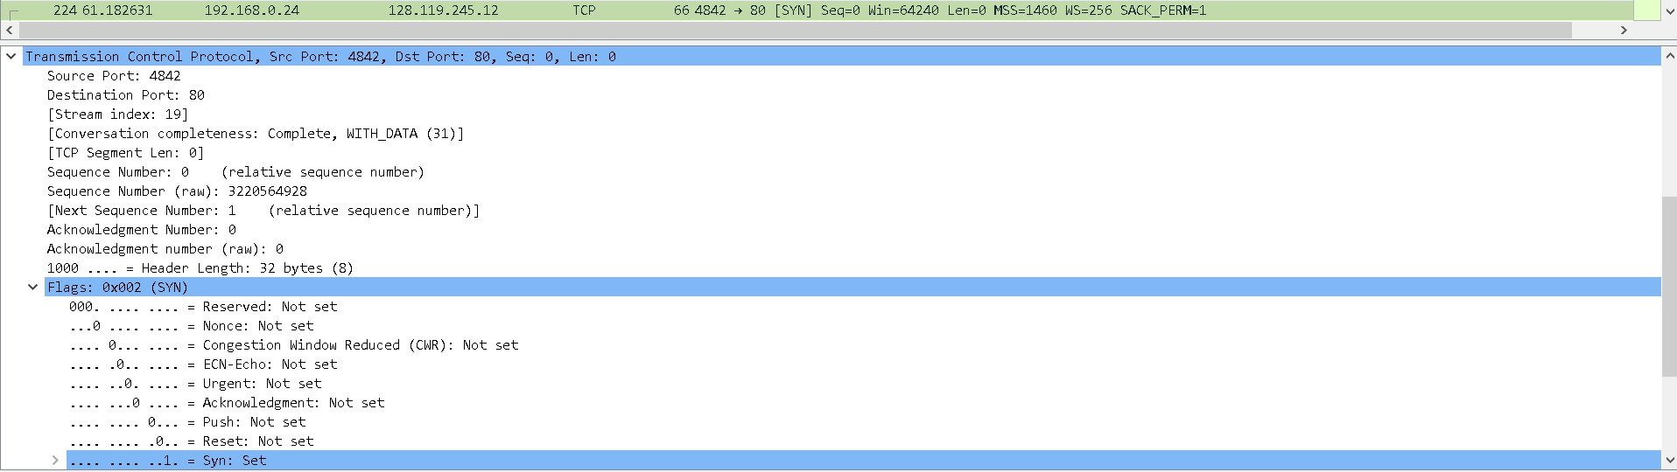
Questions (Part 2/5)
- What is the sequence number of the TCP SYN segment that is used to initiate the TCP connection between the client computer and gaia.cs.umass.edu? What is it in the segment that identifies the segment as a SYN segment?
sequence number는 0이며,
Flags의 Syn이 1로 set 되어 있는 것을 통해 SYN segment 임을 식별할 수 있다.

Slide 12
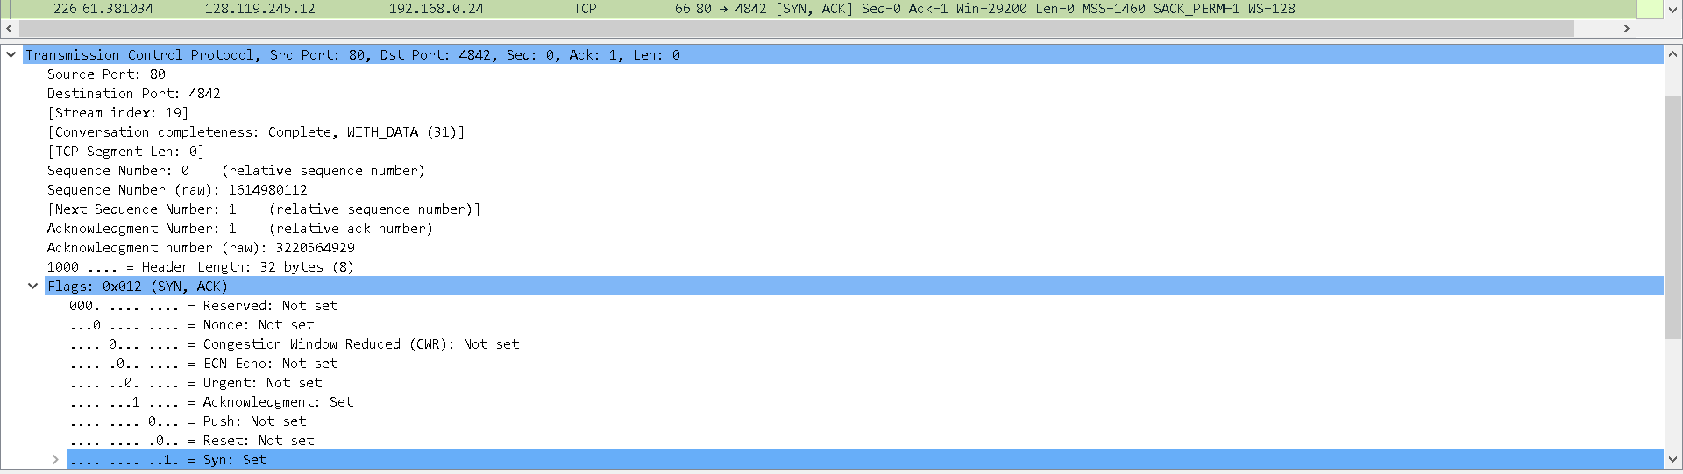
Questions (Part 2/5)
- What is the sequence number of the SYNACK segment sent by gaia.cs.umass.edu to the client computer in reply to the SYN? What is the value of the Acknowledgement field in the SYNACK segment? How did gaia.cs.umass.edu determine that value? What is it in the segment that identifies the segment as a SYNACK segment?
sequence number는 0이며,
Acknowledgement number는 1이다.
Acknowledgement number는 expected byte number로서, 다음에 올 것으로 기대하는 시퀀스 넘버를 명시한다.
0번까지는 잘 받았으므로 1을 표시했다.
Flags의 Acknowledgement와 Syn이 1로 set 되어 있는 것을 통해 SYNACK segment 임을 식별할 수 있다.

Slide 13

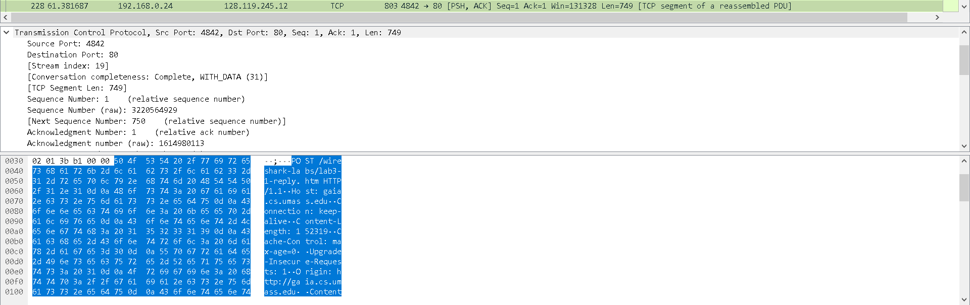
Questions (Part 2/5)
- What is the sequence number of the TCP segment containing the HTTP POST command? Note that in order to find the POST command, you’ll need to dig into the packet content field at the bottom of the Wireshark window, looking for a segment with a “POST” within its DATA field.
sequence number는 1이다.

Slide 14
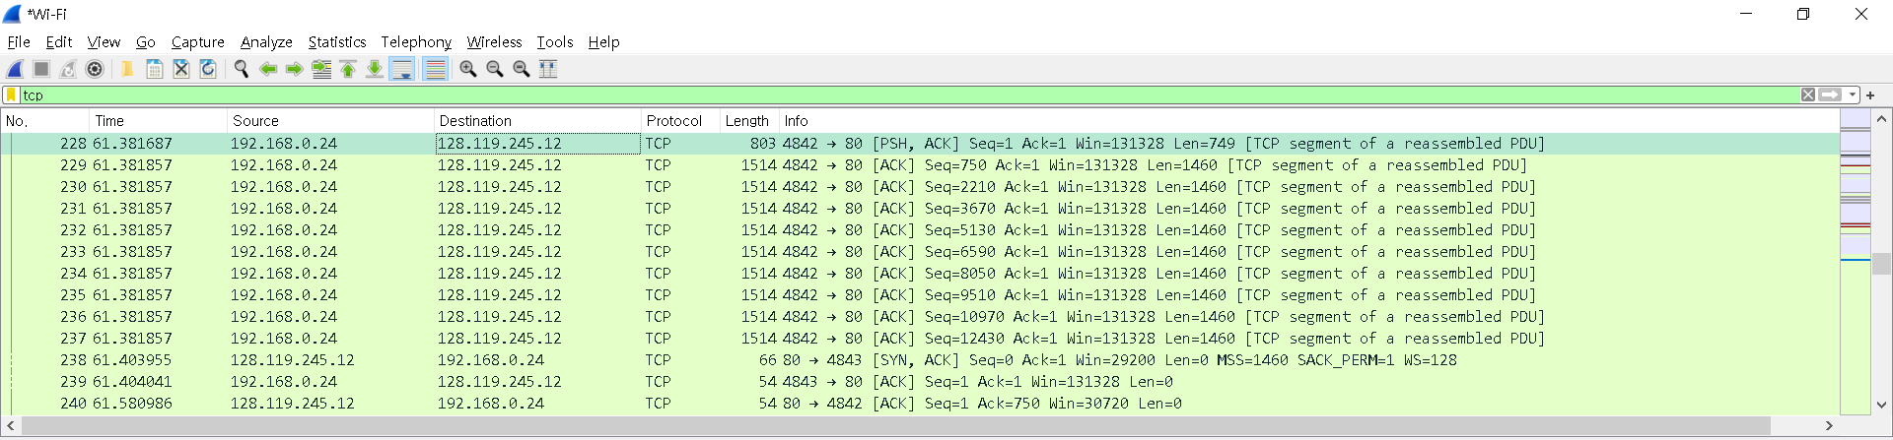
Questions (Part 3/5)
Consider the TCP segment containing the HTTP POST as the first segment in the TCP connection.
  - What are the sequence numbers of the first six segments in the TCP connection (including the segment containing the HTTP POST)?
처음 여섯 개 세그먼트의 sequence number는 각각 1, 750, 2210, 3670, 5130, 6590이다.

Slide 15
Questions (Part 3/5)
  - At what time was each segment sent? When was the ACK for each segment received?
61.381687 | 61.580986
61.381857 | 61.580986
61.381857 | 61.580986
61.381857 | 61.580986
61.381857 | 61.779801
61.381857 | 61.779801
처음 여섯 개 세그먼트의 sent time과 ACK received time
을 순서대로 나열하면 다음의 표와 같다.

Slide 16
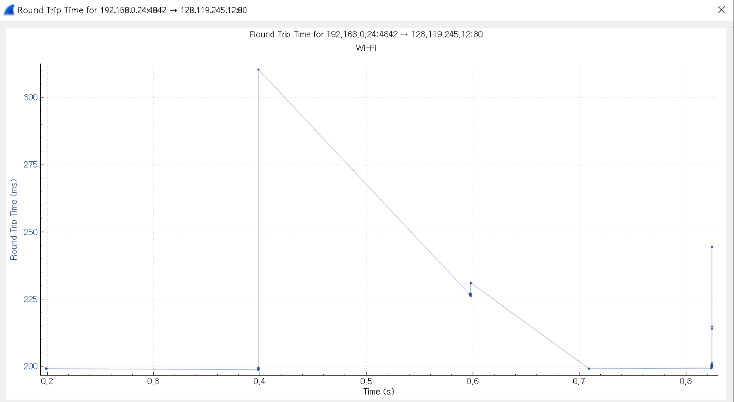
Questions (Part 3/5)
  - Given the difference between when each TCP segment was sent, and when its acknowledgement was received, what is the RTT value for each of the six segments?
  Note: Wireshark has a nice feature that allows you to plot the RTT for each of the TCP segments sent. Select a TCP segment in the “listing of captured packets” window that is being sent from the client to the gaia.cs.umass.edu server. Then select: Statistics->TCP Stream Graph->Round Trip Time Graph.
RTT value = Received time - sent time이다. 순서대로 나열하면 표와 같다.
0.199299
0.199129
0.199129
0.199129
0.397944
0.397944

Slide 17
Questions (Part 4/5)
- What is the length of each of the first six TCP segments?
처음 여섯 개 세그먼트의 length는
각각 749, 1460, 1460, 1460, 1460, 1460이다.

Slide 18
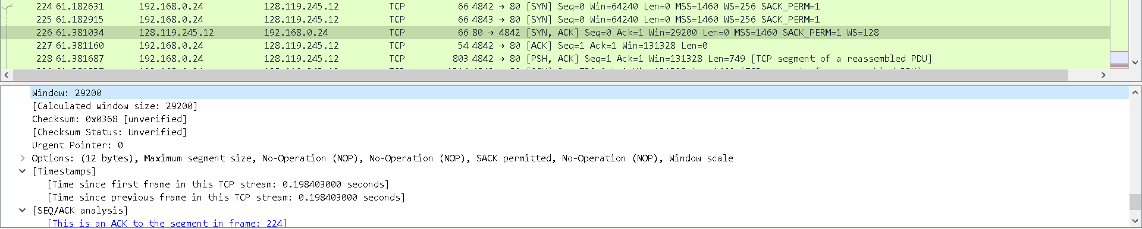
Questions (Part 4/5)
- What is the minimum amount of available buffer space advertised at the received for the entire trace? Does the lack of receiver buffer space ever throttle(차단 혹은 전송 rate 감소) the sender?
rwnd는 29200이며, 차단 혹은 전송 rate 감소되지 않는다.

Slide 19
Questions (Part 4/5)
- Are there any retransmitted segments in the trace file? What did you check for (in the trace) in order to answer this question?
retransmission된 segment는 포착되지 않았다.
이전에 전송한 패킷과 같은 패킷인지 체크해야한다.

Slide 20
Questions (Part 4/5)
- How much data does the receiver typically acknowledge in an ACK? Can you identify cases where the receiver is ACKing every other received segment (see the table on next page).
대부분 54 바이트 값을 가지는 것을 확인할 수 있었고, 모든 경우에 대해 ACKing을 하는 경우 식별 불가능했다.

Slide 21
Questions (Part 4/5)
- What is the throughput (bytes transferred per unit time) for the TCP connection? Explain how you calculated this value.
성공적으로 destination까지 도착한 데이터들의 총량을 시간으로 나눈 것이 throughput이므로 커넥션간에 포착된 마지막 패킷의, 바이트 스트림으로 구성된 시퀀스 넘버를 시간으로 나눠주면 된다.

Slide 22
Lab activities & Question for TCP congestion control
Try to upload files with various sizes
Select a TCP segment in the Wireshark’s “listing of captured-packets” window. Then select the menu : Statistics->TCP Stream Graph-> Time-Sequence-Graph(Stevens).
Question: (Part 5/5)
    Use the Time-Sequence-Graph(Stevens) plotting tool to view the sequence number versus time plot of segments being sent from the client to the gaia.cs.umass.edu server.
      Can you identify where TCP’s slowstart phase begins and ends, and where congestion avoidance takes over? Comment on ways in which the measured data differs from the idealized behavior of TCP that we’ve studied in the text.
    Answer the questions above for the trace that you have gathered when you transferred a file from your computer to gaia.cs.umass.edu

Slide 23
TCP ACK generation
[RFC 1122, RFC 2581, RFC5681]
event at receiver
arrival of in-order segment with
expected seq #. All data up to
expected seq # already ACKed
arrival of in-order segment with
expected seq #. One other
segment has ACK pending
arrival of out-of-order segment
higher-than-expect seq. # .
Gap detected
arrival of segment that
partially or completely fills gap
TCP receiver action
delayed ACK. Wait up to 500ms
for next segment. If no next segment,
send ACK
immediately send single cumulative
ACK, ACKing both in-order segments
immediately send duplicate ACK,
indicating seq. # of next expected byte
immediate send ACK, provided that
segment starts at lower end of gap

Slide 24
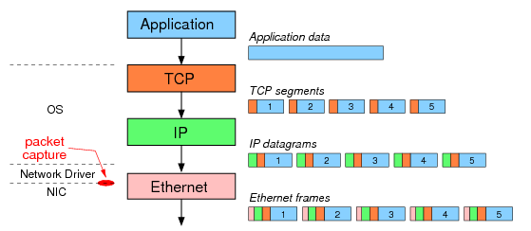
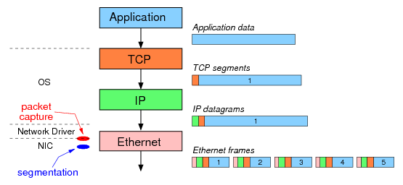
이런 경우도 있을 수 있음:
TCP Large Segment Offloading (TSO)
PC without TSO option
PC with TSO option
The result: although the same 5 Ethernet frames are sent over the network, Wireshark captures different data depending on the use of segmentation offloading.

